Slide 1
Diversity & Inclusion

Slide 2
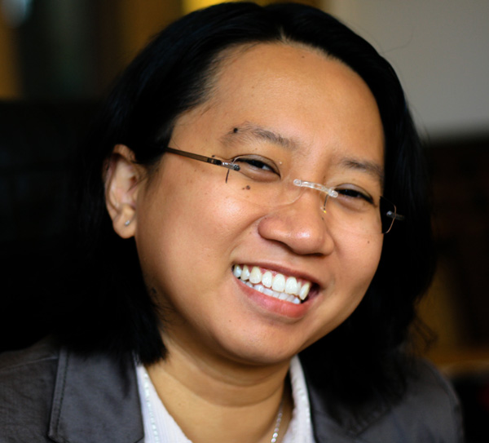

Who We Are?
Co-Chairs - Informatics Diversity & Inclusion Committee
Dr Alfie Abdul-Rahman
Lecturer in Informatics
Dr Petr Slovak
Lecturer in Informatics

Slide 3
Why do we care about diversity and inclusion?
Part of our moral and legal obligation to enable equality, access, and fairness
One of the central tenets of King’s Vision 2029
Notes:
Your health and wellbeing are important, therefore we advocate that students take reasonable steps to support themselves.
All students will be sent a link to the H&S presentation, it is your responsibility to ensure that you familiarise yourself with the following:
Advice on the College website about personal safety in London
Faculty health & safety arrangements
Department health & safety arrangements
All students should complete the Safety E-Learning on KEATS (MUST COMPLETE)

Slide 4
Why do we care about diversity and inclusion?
Leads to better science, better business, better decisions:
Sharing of different knowledge, working styles, skills, experiences and techniques.
Explaining our ideas to people different to us means we have to think better about our arguments.
People with different perspectives ask different questions and have different approaches, more innovation and creativity.
Notes:
Your health and wellbeing are important, therefore we advocate that students take reasonable steps to support themselves.
All students will be sent a link to the H&S presentation, it is your responsibility to ensure that you familiarise yourself with the following:
Advice on the College website about personal safety in London
Faculty health & safety arrangements
Department health & safety arrangements
All students should complete the Safety E-Learning on KEATS (MUST COMPLETE)

Slide 5
Why do we care about diversity and inclusion?
Forbes study: Diversity is a key driver of innovation and critical for global success.
Credit Suisse study: Compared with companies with no female board members, companies with at least one woman on the board saw 26% better performance over 6 years.
McKinsey study: Companies with diverse executive boards enjoy 14% higher earnings and 53% higher returns on equity (on average).
Notes:
Your health and wellbeing are important, therefore we advocate that students take reasonable steps to support themselves.
All students will be sent a link to the H&S presentation, it is your responsibility to ensure that you familiarise yourself with the following:
Advice on the College website about personal safety in London
Faculty health & safety arrangements
Department health & safety arrangements
All students should complete the Safety E-Learning on KEATS (MUST COMPLETE)

Slide 6
What is diversity and inclusion?
Diversity is a ‘fact’ in time
Inclusion is behaviour
Notes:
A mantra that I personally like very much is this one:
By talking about diversity as a `state’ I mean that it reflects the environment we are in at any given time – how successful was Kings in recruiting and retaining a diverse set of students and staff in the year that you are just starting in
Diversity in this sense is seen as having people across the dimensions that have—sadly—traditionally differed in access and opportunities: whether that is sex, gender, race, age, nationality, disability, religion, sexual orientation
By talking about about inclusion as behaviour emphasises that inclusion is what we, as students and staff members, can do every day.

Slide 7
What do we mean by inclusion?
All people feel welcome, included and supported.
No one is unfairly disadvantaged.
Notes:
In general terms, it means that we are very serious about ensuring that all people feel [...]

Slide 8
Expectations of inclusive behaviour
Staff and students are expected to behave respectfully to one another – during lectures, outside of lectures and when communicating online or through email.
Be thoughtful of the way your actions and words might impact on others.
We will not tolerate inappropriate or demeaning comments related to gender, gender identity and expression, sexual orientation, disability, physical appearance, race, religion, age, or any other personal characteristic.
Notes:
As you will be reminded in your lectures and elsewhere, KCL places serious expectations on all of us about our behaviour.
This includes staff as well as students, with the expectation that we behave [...]
.....

Slide 9
Expectations of inclusive behaviour
If you witness or experience any behaviour you are concerned about, please speak to someone about it.
This could be one of your lecturers, your personal tutor, a programme administrator, us, or any other member of staff you feel comfortable talking to.
More info: kcl.ac.uk/harassment
Notes:
In general terms, it means that we are very serious about ensuring that all people feel [...]

Slide 10


Professional Skills for a Globalised World
Online KEATS module, all students must complete.
“Only by actively engaging different perspectives can we challenge and stretch our thinking, enrich the experiences of our employees, and empower every person and every organization on the planet to achieve more.” – Google
In the modern globalised work environment, it is crucial that you are able to work effectively with people from different backgrounds and with different perspectives.
This module will provide you with knowledge and skills to help you achieve this.
The course takes around 1 hour to complete. Please complete the course by the end of the semester.
After completion of the course, you will receive a certificate and be able to list the training on your CV.
You will receive an email soon with details of how to access the course.

Slide 11


Diversity and inclusion training
King’s and KCLSU have collaborated to create IT Stops Here campaign to challenge sexual harassment
Please complete the KEATS course Consent Matters: Boundaries, Respect and Positive Intervention
Active Bystander training
@KCLItStopsHere
Notes:
In general terms, it means that we are very serious about ensuring that all people feel [...]

Slide 12
Get in touch
If you have any suggestions, any concerns, or want to get involved with our diversity and inclusion work, please get in touch with us at:
informatics-diversity@kcl.ac.uk
Notes:
In general terms, it means that we are very serious about ensuring that all people feel [...]

